Slide 1
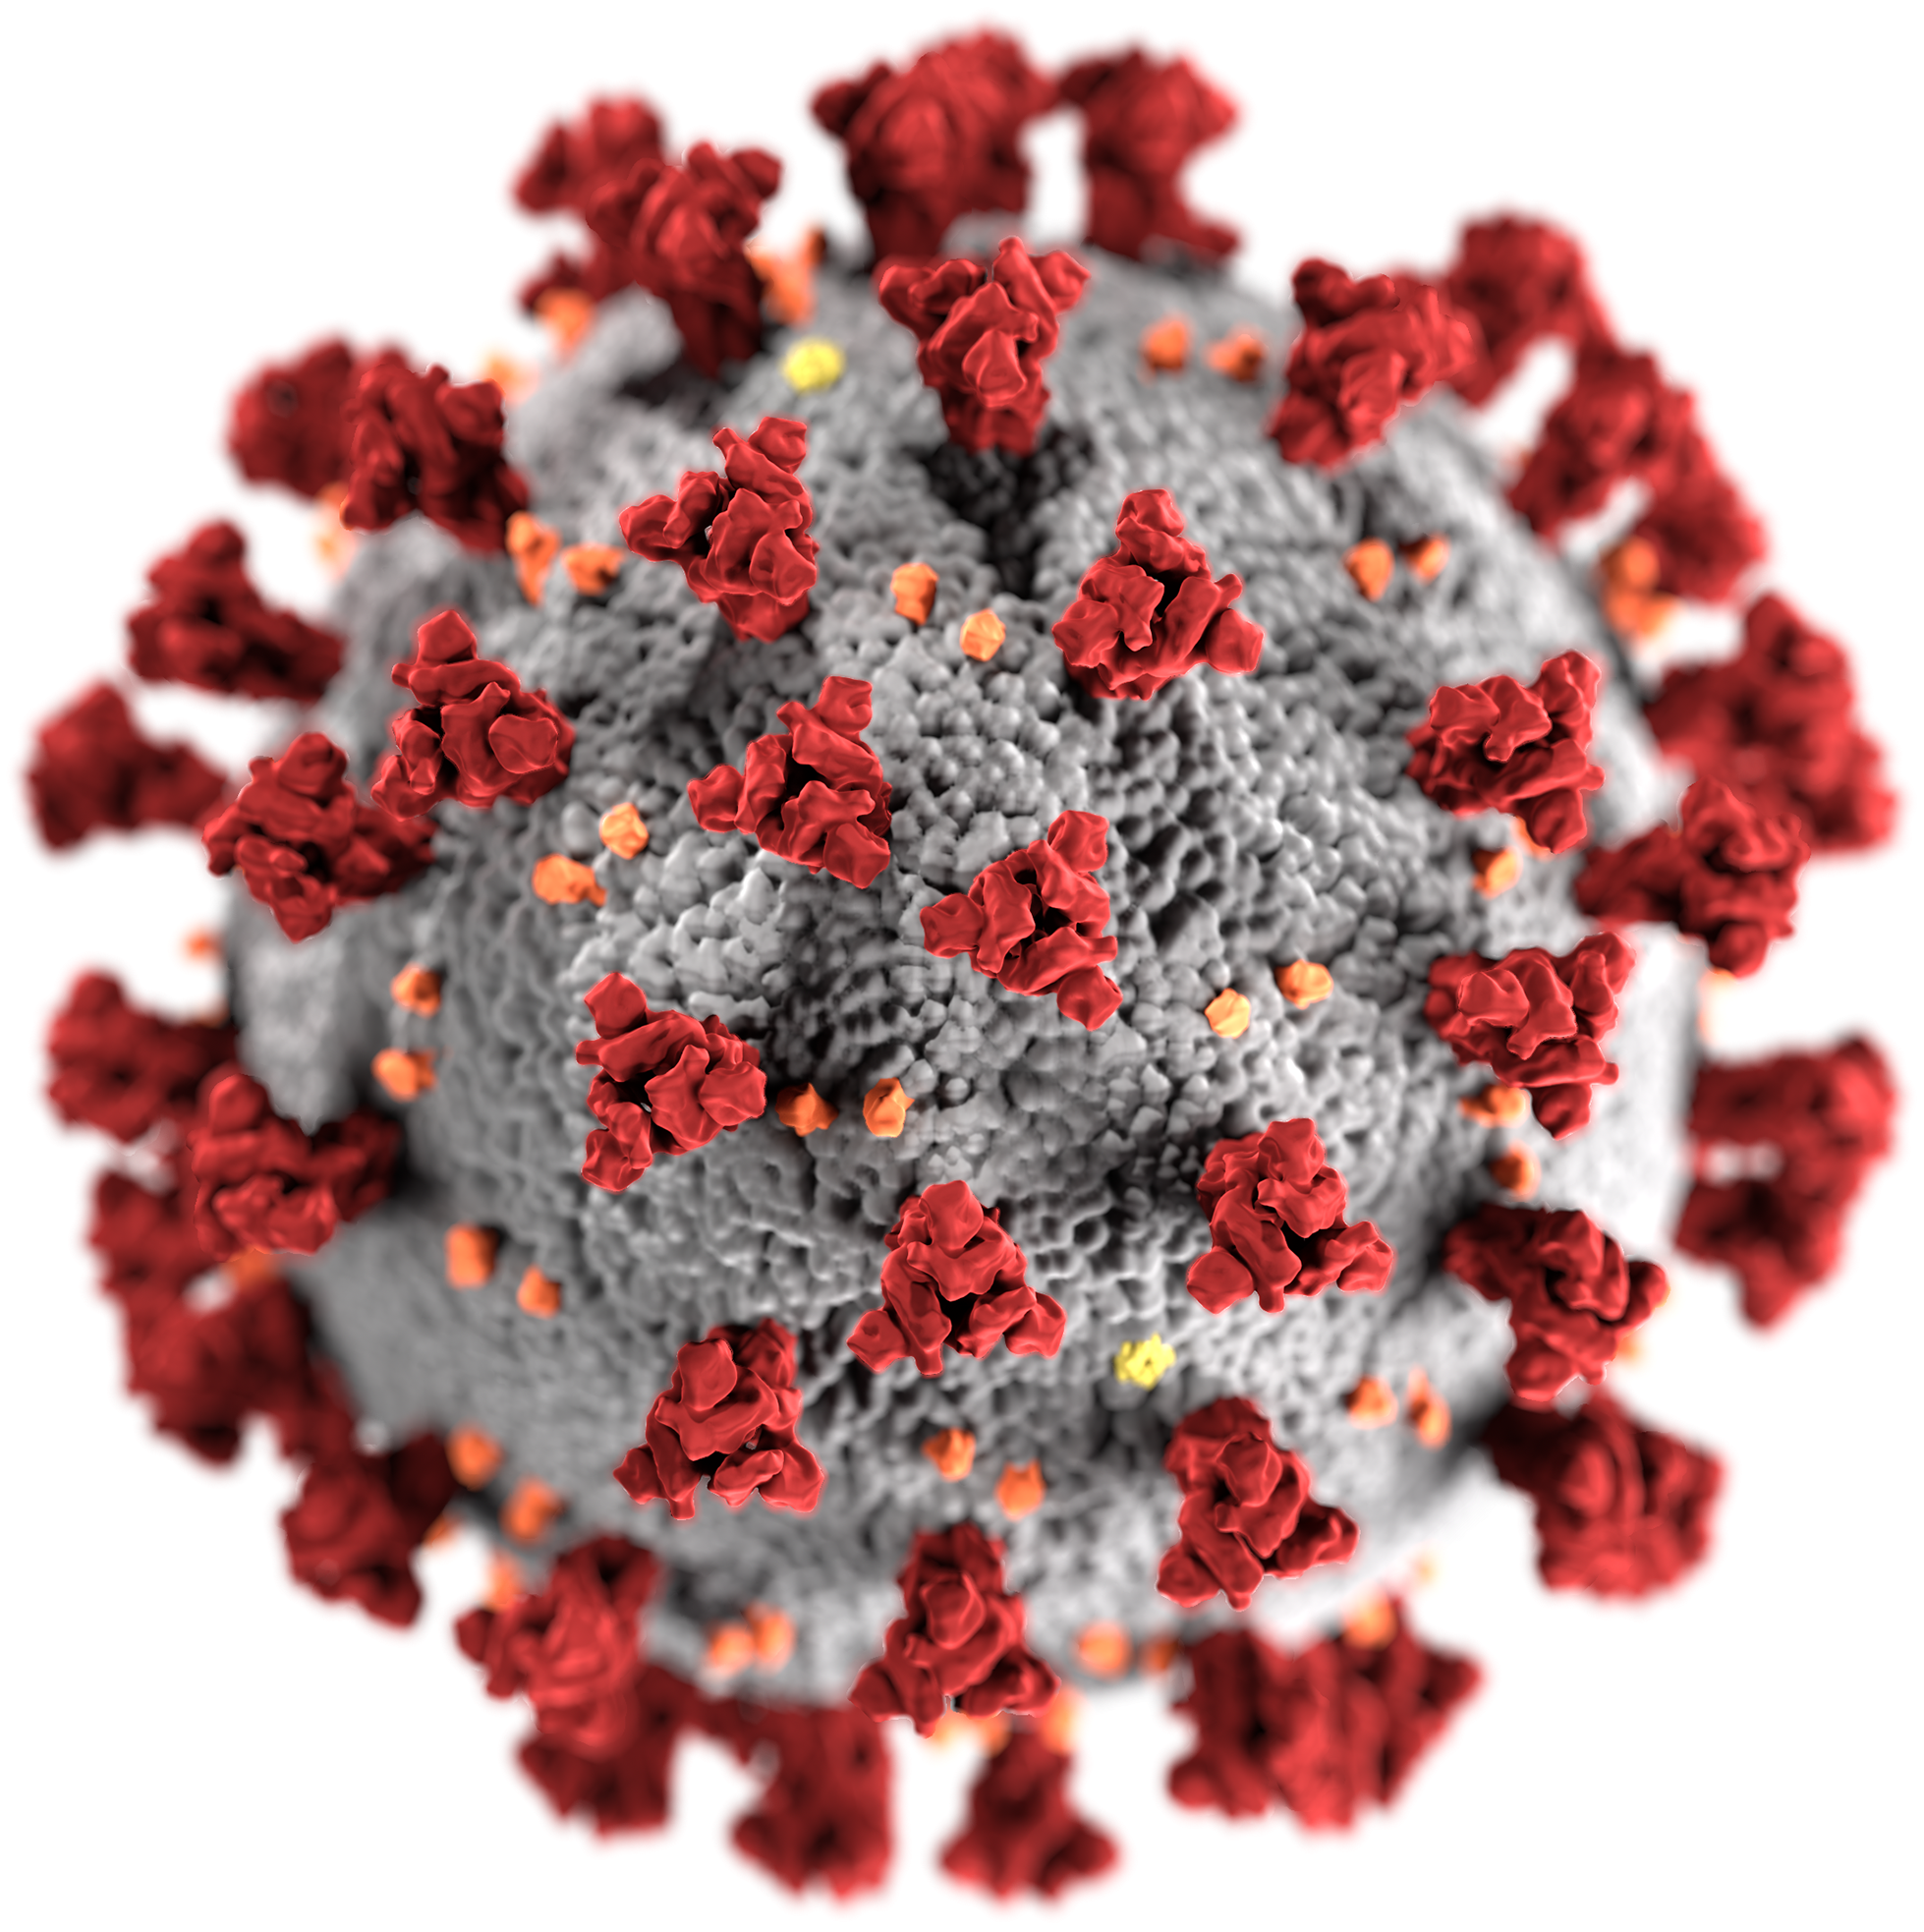
PATIENT-PHYSICIAN INTERACTION IN HAE
LEARNINGS FROM LOCKDOWN
Chair
Marcus Maurer
Dermatological Allergology
Allergie-Centrum-Charité
Department of Dermatology and Allergy
Charité - Universitätsmedizin Berlin
EUR-BRN-0171

Slide 2
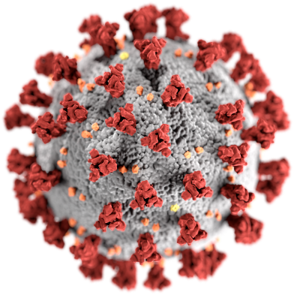
WELCOME AND INTRODUCTION
Marcus Maurer
Dermatological Allergology
Allergie-Centrum-Charité
Department of Dermatology and Allergy
Charité - Universitätsmedizin Berlin

Slide 3
Please submit your questions via Zoom during the presentations, to be answered in the Q & A session

Slide 4
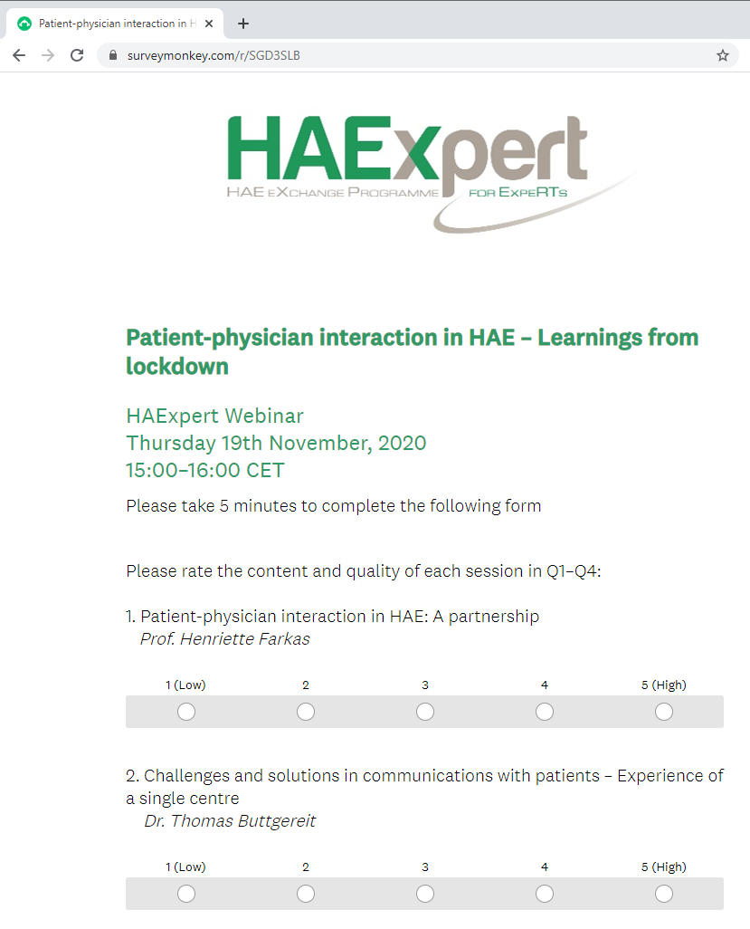
Please complete the short feedback form that opens automatically in your web browser at the end of the webinar
Thank you

Slide 5
Programme
TOPIC | PRESENTER | TIME (CET)
Patient-physician interaction in HAE: A partnership | H. Farkas | 15.05
Challenges and solutions in communication with patients – Experience of a single center | T. Buttgereit | 15.15
Challenges and solutions in communication with physicians – Experience of an HAE patient | K. Schön | 15.25
What we should preserve from our experience | M. Maurer | 15.35
Q & A | Faculty | 15.45
Summary and close | M. Maurer | 15.55

Slide 6
Disclosures
MM: Research grant support and/or speaker/consultancy fees from Adverum, Attune, BioCryst, CSL Behring, Jerini/Dyax/Shire/Takeda, Kalvista, and Pharvaris
HF: Research grants from CSL Behring, Shire/Takeda and Pharming and has served as an advisor for these companies and Biocryst, and has participated in clinical trials/registries for BioCryst, CSL Behring, Pharming, Kalvista and Shire/Takeda
TB: Speaker/consultancy fees from CSL Behring, Shire/Takeda and Pharming
KS: Speaker fees from CSL Behring
10-2020, last 5 years

Slide 7
SARS-CoV-2 and COVID-19
Novel Coronavirus
Severe acute respiratory syndrome
CORONA
Zoonotic origin
Spreads between people
Respiratory droplets

Slide 8
SARS-CoV-2 and COVID-19
Dec 2019
China alerts WHO to several pneumonia cases
Jan 7
France confirms Europe's first COVID-19 case
Jan 11
China announces first death from COVID-19
Feb 11
Disease caused by virus SARS-CoV-2 is named COVID-19
Apr 2020
Infected: > 3 Million
Deaths: > 200.000
Mar 11
WHO declares pandemic
Feb 14
Egypt confirms Africa’s first case
of COVID-19
Sep 2020
Infected: > 30 Million
Deaths: > 1 Million
Now
When do we
get a vaccine?

Slide 9
SARS-CoV-2 and COVID-19
Shortness of breath
High Fever
Diarrhoea
(in some cases)
Vomiting
(in some cases)
Coughing
Pneumonia

Slide 10
SARS-CoV-2 and COVID-19
Shortness of breath
WHAT ABOUT HAE?
High Fever
Diarrhea
(In Some Cases)
Vomiting
(In Some Cases)
Coughing
Pneumonia

Slide 11
The COVID-19 pandemic and HAE
Wash Hands with water and soap/Sanitiser, at least 20 Seconds
Don’t touch eyes, nose or mouth with unwashed hands
Keep objects and surface clean
Wear a surgical mask
Avoid contact with sick people
Stay at home
Cover your nose and mouth
when sneezing

Slide 12
PATIENT-PHYSICIAN INTERACTION IN HAE:
A PARTNERSHIP
Henriette FARKAS
Hungarian Angioedema Center of Reference and Excellence (ACARE)
Internal Medicine and Haematology Clinic
Semmelweis University
Budapest, Hungary

Slide 13


PATIENT-PHYSICIAN INTERACTION IN HAE: A PARTNERSHIP
Paternalistic model
Physician dominates decision making process
Shared decision making
Collaborative process between patient and HCP
Informed patient
choice model
Physician provides information, patient assumes leading role
Shift toward patient-centered care and increasingly prominent role of patient
Shared decision making:
  Augments patients’ satisfaction with care
  Patients have better understanding of treatments → better compliance → positive impact on outcomes
Shared decision making has particular relevance in rare diseases:
  Given scarce information, patients often become “experts” of their own disease¹
Even greater relevance of shared decision making in HAE:
  Intra- and inter-individual variation/fluctuation necessitates ongoing collaboration
  Potential of life-threatening attacks
Examples in HAE – guidelines/consensus
“We recommend that patients are evaluated for long-term prophylaxis at every visit. Disease burden and patient preference should be taken into consideration.” ²
““The aim of HAE-1/2 management at all ages should be to normalize life activities and lifestyle whenever possible.” ³
1. Babac A, et al. BMC Med Inform Decis Mak. 2019 Sep 18;19(1):188.
2. Maurer M, et al. Allergy. 2018;73:1575–1596.
3. Farkas H, et al. Allergy. 2017;72:300-313.

Slide 14
AUDIENCE POLL
  Which of the following do you think patients with HAE rate as most important?:
    Access to the emergency room
    Access to their general practitioner
    Access to HAE treatment
    Access to their HAE specialist

Slide 15
HAE SURVEY IN HUNGARY
  Telephone interview conducted in Aug 2020
  37 patients (followed up more than 5 years in Hungarian angioedema Center of Reference and Excellence)
  Importance of access to their different physicians and drug for HAE in rank order
Rank of importance to patient
Access to Emergency Unit
Access to
General Practitioner
Access to
HAE Treatment
Access to
HAE Specialist

Slide 16
HAE SURVEY FINDINGS: “ACCESS TO PHYSICIANS IS MORE IMPORTANT THAN THE AVAILABILITY OF PHARMACEUTICALS”
WHY?
  COVID-19 is a new pandemic; its pathophysiology and course have not been explored, especially in patients with HAE
  Patients are afraid and insecure
  Several important issues are raised
  Communicating with their physician provides patients with a feeling of security

Slide 17
What can we do for HAE patients? GENERAL CONSIDERATIONS
COUNSELLING
  To calm the patient down
  To supply them with information:
    Following the general rules regarding COVID-19
        Frequency of HAE attacks may increase during COVID-19 infection
  Display information on websites
HOTLINE SERVICE
  To provide the patients and local physicians with continuous access to an HAE expert and an HAE nurse via a hotline service
NEW INFORMATION
  Researching novel literature and inform patients about new findings
        No publications on COVID-19-infected patients with HAE
        Role of kallikrein-kinin blockade in patients with COVID-19 – treatments for HAE could potentially help in patients with COVID-19

Slide 18



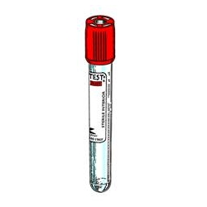
What can we do for the patients?
patients WITH suspected HAE
  Ask the physicians to fill in the Request for
  Consultation form
  Consultation with local physicians and GPs by phone, e-mail or video call
LOCAL
HEALTH CARE
HAE CENTER
Provide physicians with information about the preparation, storage and transfer of the blood samples for complement and genetic testing

Slide 19

What can we do for the patients?
Newly diagnosed Patients with HAE
Contact the newly diagnosed patients by phone or videocall, fill out the initial visit form and register the patient in the HAE Registry
Provide the patient with a “package”
Create an individual treatment plan, follow-up
HAE CENTER
LOCAL
HEALTH CARE
Training for
self-administration

Slide 20

What can we do for the patients?
FAMILY SCREENING OF THE Newly diagnosed Patients with HAE
LOCAL
HEALTH CARE
HAE CENTER
Screen all asymptomatic and symptomatic relatives of the newly diagnosed patients by sending their blood samples to the center

Slide 21
What can we do for the patients?
Regular follow-up OF patients with HAE
Perform yearly follow-up visits via telemedicine, re-educate the patient and revise the treatment strategy
Ensure the availability of emergency care in the center and by the hotline service
Suggest storage of targeted drugs for acute treatment in the local hospital
Keep contact with pharmaceutical companies and pharmacists for ensuring a continuous drug supply
HAE CENTER
LOCAL
HEALTH CARE
Ensure the availability of emergency care
Perform laboratory or US check up if it necessary

Slide 22

What can we do for the patients?
CONSIDERATIONS REGARDING THE TREATMENT STRATEGY – ACUTE TREATMENT
HAE CENTER
Self-administration
As soon as possible
LOCAL
HEALTH CARE
Laryngeal edema and/or abdominal symptoms that do not ease after the administration of acute treatment

Slide 23

What can we do for the patients?
CONSIDERATIONS REGARDING PROPHYLACTIC TREATMENT STRATEGY
Psychological stress and infection are known triggers of HAE attacks¹
Consider the introduction of transient/intermittent drug prophylaxis:
  If the patient has symptoms of upper airway infection or they are infected with COVID-19
  If the patient is worried or scared
  If the patient lives far from the hospital
Regarding the important role of the kinin-kallikrein system in COVID-19 infection, could the inhibition of bradykinin production while using targeted drugs for long-term prophlaxis of HAE attacks prevent the development of a more severe course of COVID-19 infection?
¹ Maurer M, et al. Allergy. 2018;73:1575–1596

Slide 24
IN SUMMARY
Face-to-face consultation with patients
Follow-up visits at the center in person
Taking blood samples at the center
Prescribing paper prescriptions
Telecommunication with patients, physicians
and nurses
24-hour, 7-day hotline service
Transportation of blood samples for diagnosis
Drug storage at home for more than two attacks and in local hospitals
Preference for self-administration of drugs as early as possible
Introducing intermittent prophylactic treatments
LOCKDOWN
PRE-LOCKDOWN

Slide 25


Take care!

Slide 26
CHALLENGES AND SOLUTIONS IN COMMUNICATION WITH PATIENTS – EXPERIENCE OF A SINGLE CENTER
Thomas Buttgereit
Dermatological Allergology
Allergie-Centrum-Charité
Department of Dermatology and Allergy
Charité - Universitätsmedizin Berlin

Slide 27
General Challenges in patient-physician interaction
REACHING PATIENTS
CARE
RISK ASSESSMENT
COMMUNICATION

Slide 28
General Challenges in patient-physician interaction
DURING Lockdown
REACHING PATIENTS
COMMUNICATION WITHOUT FACE-TO-FACE INTERACTION IN HAE?
CARE
RISK ASSESSMENT
COMMUNICATION

Slide 29

Challenges in communication without Face-to-face CONTACT
Different patient requirements for telephone and/or video calls
Limitations in non-verbal communication
    Facial expressions
    Gestures
    Body posture
Understanding problems (volume/connectivity problems)
No possibilities of clinical examination

Slide 30

Challenges in communication – newly diagnosed patients
Changing conditions for the delivery of bad news
Limited opportunities for disease awareness
Limited possibilities of offering further diagnostics
Restricted guidance on the administration of medication
    Intravenously
    Subcutaneously

Slide 31


Challenges in communication – FOLLOW-UP CONSULTATIONS
Difficulties in dealing with patient-reported outcome (PRO) tools
Influence on assessment of prophylactic vs. acute treatment options
Limitations to show empathy
The feeling that the patient is not communicating everything

Slide 32

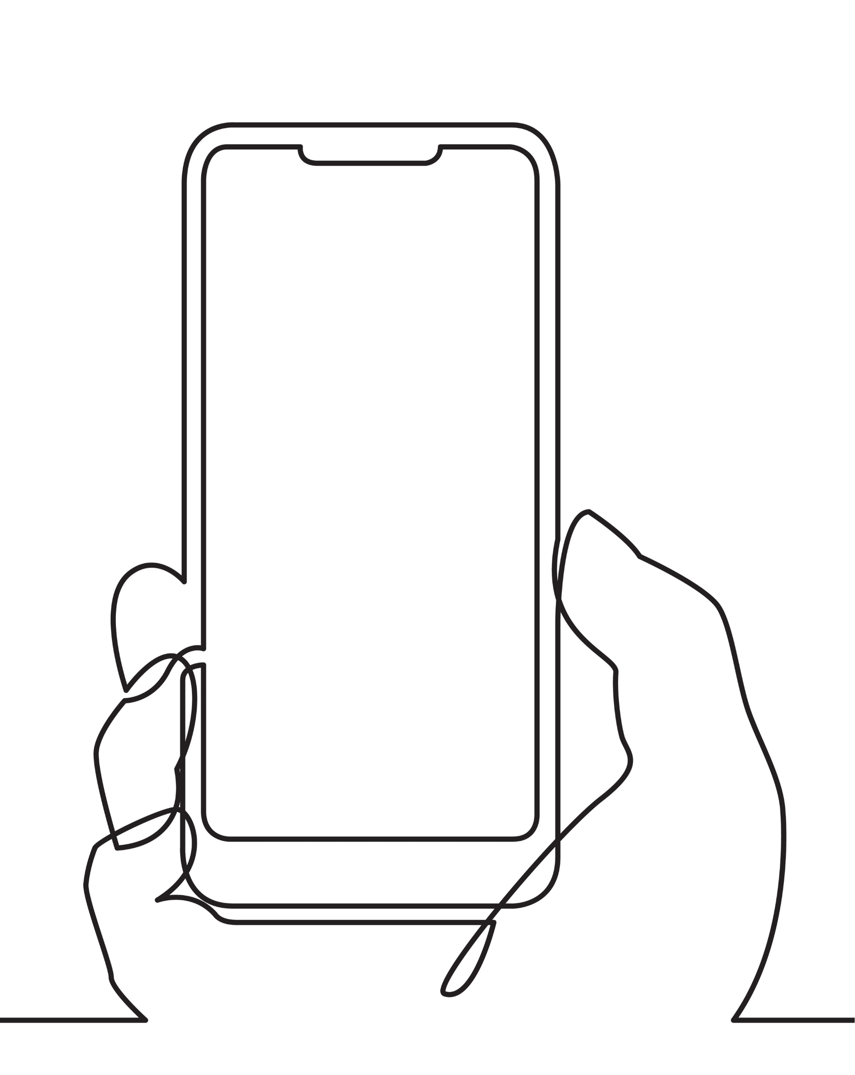


Solutions in communication
Video call consultations as options to see patients living further away
Video calls as a useful measure for follow up / well-controlled patients
Development of PRO tools for smart devices

Slide 33
AUDIENCE POLL
  Would you consider short-term prophylaxis for your patient due to stress or infection if the patient asks for it in the current situation?
    Yes
    Possibly, if attack frequency has increased
    No

Slide 34

www.acare-network.com

Slide 35


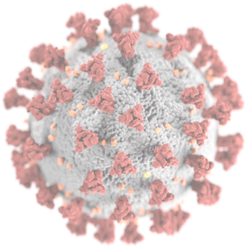


TO HAVE HAE IN THE TIMES OF COVID-19

Slide 36
CHALLENGES AND SOLUTIONS IN COMMUNICATION WITH physicians – EXPERIENCE OF AN HAE PATIENT
Kathrin Schön
HAE patient
Marburg, Germany

Slide 37
PATIENT EXPERIENCE DURING LOCKDOWN
“I am seriously concerned about my mental health”
- Patient with Caroli disease²
“Most of the time it’s just there, a constant gnawing feeling at the pit of my stomach. Navigating a pandemic when you’re ‘vulnerable’ is far from easy”
- Patient with multiple sclerosis¹
“I do believe if we all stick together and support each other we will come through this stronger”
- Patient with biliary atresia²
https://www.neuro-central.com/navigating-the-covid-19-pandemic-a-new-way-of-living-for-people-with-multiple-sclerosis/
https://britishlivertrust.org.uk/your-stories-of-life-in-lockdown/

Slide 38
Challenges and solutions in communication with physicians – Experience of an HAE patient
I’m a 26-year-old patient with HAE type 2 living in Marburg, Germany
Treated with on-demand C1-esterase-inhibitor from diagnosis until this year
  I switched to prophylactic treatment in February

Slide 39
Challenges and solutions in communication with physicians – Experience of an HAE patient
Normal way of communication: face-to-face / in person
For me: possible
      Different opening hours of the medical practice
      No patient-patient meetings
      Standard / normal care and treatment
Still possible? For how long?
What‘s next?
How to reach your physician? How to get your medication?
How to talk about your thoughts / fears / issues?

Slide 40




Challenges and solutions in communication with physicians – Experience of an HAE patient

Slide 41
Challenges and solutions in communication with physicians – Experience of an HAE patient
Hard copy
Archived
Re-readable
Binding
Think twice
Set your own pace
Archived
Formal, not emotional
Hiding fears / thoughts
Empathy?
Reaction of counterpart?
Distance

Slide 42
Challenges and solutions in communication with physicians – Experience of an HAE patient
Closer to in-person conversation
Reaction of the counterpart
Voice, facial expressions
More personal, intimate
  Talking about fears
Access?
Conditions?
Elderly patients?
  Dependent on others
Data protection?
Recording?

Slide 43
AUDIENCE POLL
Which communication method do your patients prefer, if available?

Slide 44
IN SUMMARY
In addition to regular consultations, the possibility to reach out to your physician is important!
Accessibility / availability
Reassurance
Trust as basis for relationship

Slide 45
HOW DOES THE COVID-19 PANDEMIC
IMPACT OUR PATIENTS WITH HAE?

Slide 46
WHAT WE SHOULD PRESERVE FROM OUR EXPERIENCE
Marcus Maurer
Dermatological Allergology
Allergie-Centrum-Charité
Department of Dermatology and Allergy
Charité - Universitätsmedizin Berlin

Slide 47
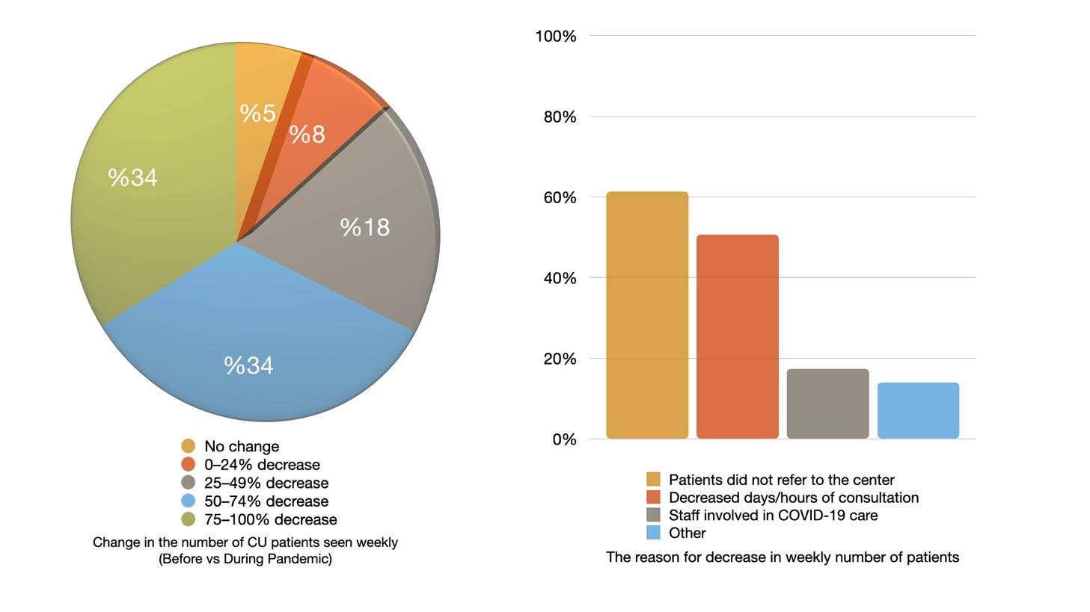
Centers of reference and excellence see markedly FEWER patients during the pandemic
Kocaturk et al., The UCARE COVID-CU study, 2020

Slide 48
Centers of reference and excellence see markedly FEWER patients during the pandemic
Kocaturk et al., The UCARE COVID-CU study, 2020

Slide 49
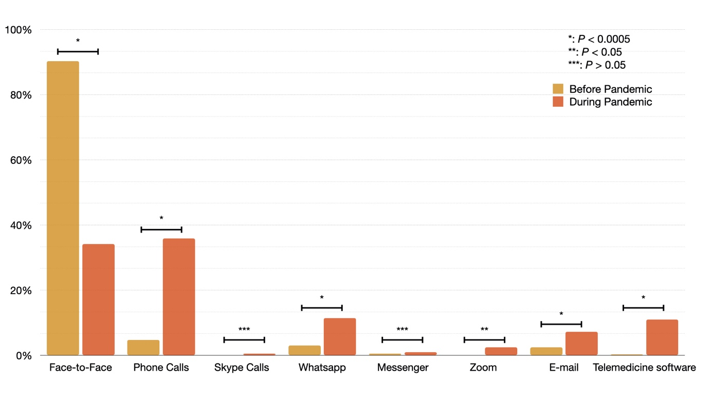
In-person consultations decreased, and remote consultations increased
Kocaturk et al., The UCARE COVID-CU study, 2020

Slide 50
The impact of the COVID-19 pandemic on the Charíte ACARE patients
In person consultation
-60%
Telephone
e-mail
Video call
+50%
PROMs
-30%
PROMS, patient-reported outcome measures

Slide 51
HAE Monitoring
1. Activity
2. Impact
3. Control

Slide 52
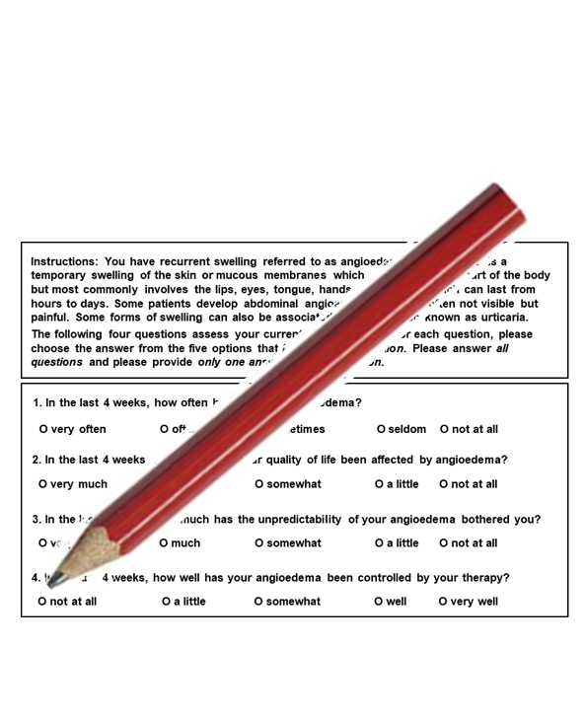
HAE monitoring during the pandemic

Slide 53
LESSONS AND SOLUTIONS FROM THE LOCKDOWN

Slide 54
IN SUMMARY
Meaningful patient-physician conversations are critical
Videoconferencing > telephone call > e-mail
Physicians need to be aware of the concerns of their patients, explore them pro-actively
Encouragement and empowerment
Focus on the concept of control
The significance of prophylactic treatment

Slide 55




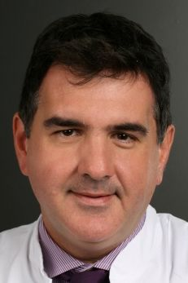


























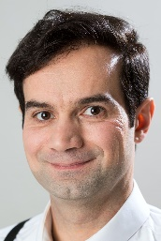




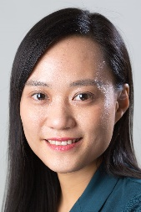
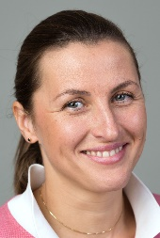




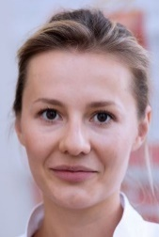












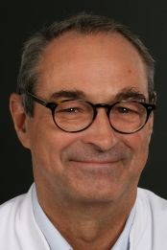
Division of Dermatological Allergology www.allergie-centrum-charite.de
The Charité ACARE
marcus.maurer@charite.de

Slide 56
www.acare-network.com

Slide 57
Q & A

Slide 58
Please complete the short feedback form
Thank you

